Slide 1

ASP.NET Core SignalR
Real-Time Applications, Live Communication, SignalR, Hubs
SoftUni Team
Technical Trainers
Software University
https://softuni.bg

Slide 2
Table of Contents
Real-Time Applications
Web Communication Fundamentals
Short Polling
Long Polling
Server-Sent Events
WebSockets
Remote Procedure Calls
ASP.NET Core SignalR
Real-time chat application with SignalR

Slide 3
Have a Question?
sli.do #csharp-web

Slide 4

Candidates, Live Communication, Benefits
Real-Time Applications

Slide 5

Real-Time Applications
Real-Time Applications are essentially live communication apps
They function within a time frame usually sensed as immediate
They have two-way communication between client and server
Real-Time Application are used in many cases:
Gaming
Auctions, Betting
Stock quotes, Crypto
Email clients
Social media, Chats

Slide 6
Real-Time Applications
RTAs use live communication to optimize functionality
This makes them more interactive and comfortable to use
Live communication often requires additional web protocols
Like the WebSocket communication protocol for example
Live communication requires some, unnatural for HTTP, processes
Server sending data without the Client requesting it
This feature is also known as Server Push – it is included in HTTP/2
Two-way data transfer over a single connection (Full-Duplex)

Slide 7
Real-Time Applications
RTAs solve many problems in the web applications world
Fast Information delivery
Imagine having to refresh a page to check actual live data
This would be catastrophic for crypto apps / betting apps
Interactivity, Comfort and Usability
Imagine having to refresh a chat to check if your friend sent a message
Your clients won’t be satisfied with such functionality needs

Slide 8
Real-Time Applications
Live communication is currently a very common thing
In fact, you are probably watching a live-stream at the moment
This is also considered live communication
Live communication is probably used the most in the gaming industry
Multiplayer Games need a live connection with players
There are many in-game events that require this feature
It won't be very appropriate for players to restart the game just to realize they lost
Even the simplest online game of Chess uses live communication

Slide 9

Polling, Server-Sent Events, Remote Procedure Calls

Slide 10


Polling (1)
Polling is a technique by which the client requests data regularly
New data is requested at frequent intervals
Works with HTTP requests and responses
There are generally two ways of Polling
Short Polling
An AJAX-based timer, that calls at fixed delays
Long Polling
The server holds the request open until new data is available

Slide 11
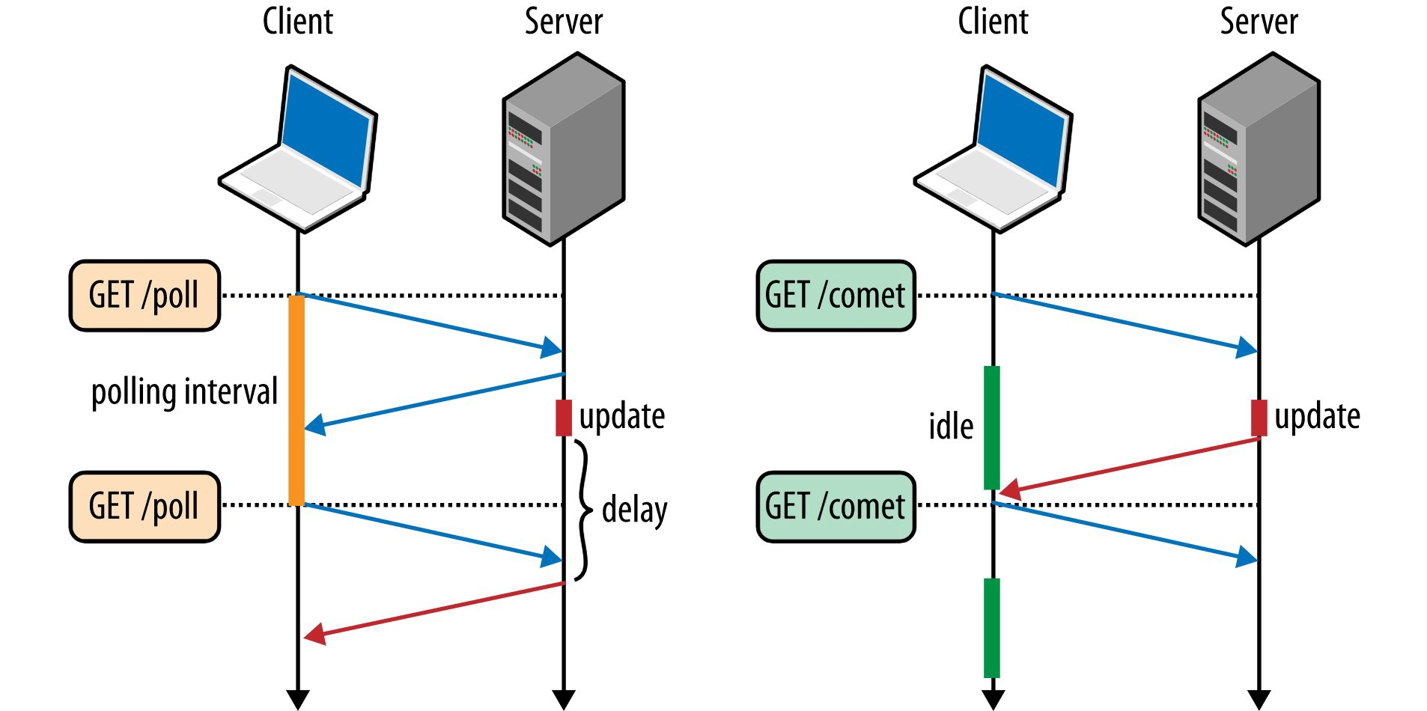
Polling (2)
Each of the 2 ways of Polling has its advantages and disadvantages
Short Polling requires less server resource consumption
Practically useless if you need server event notification with no delay
Blasts your clients’ internet data (if its limited)
Long Polling notifies you about server events with no delay
Good for the bandwidth
More complex to develop and manage
Requires more server resources

Slide 12


Short Polling – Process Explained
Short Polling is the process of frequent calls (checks) for actual data
Update?
Server
Nope.
Client
Update?
Nope.
Data update
Update?
Yep.

Slide 13
Long Polling – Process Explained
Long Polling is the process of holding a request open until update
Request
Keep-Alive
Server
Client
Timeout.
Request
Keep-Alive
Data update
Response!
Request
Keep-Alive

Slide 14
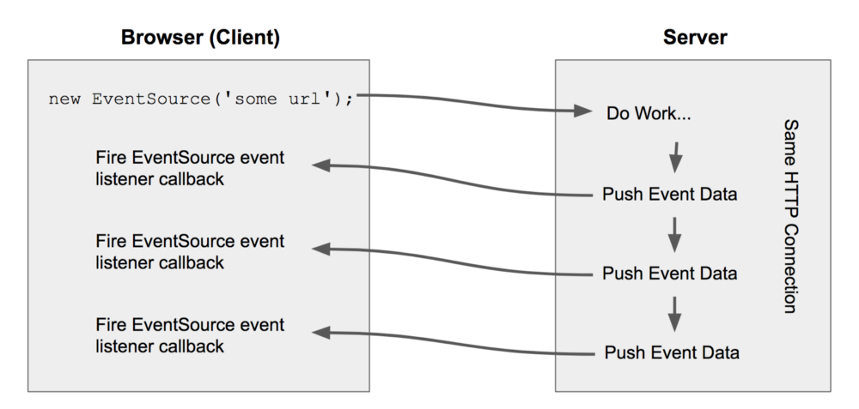
Server-Sent Events
SSE is a technology enabling a browser to receive automatic updates from a server via HTTP connection
Client doesn't have to make a request to check if updates are available
It is a one-way channel
SSE requires an initial handshake
Server leaves the response open
Until there are no more events
Until the connection has been considered stale
Until the client explicitly closes the initial request

Slide 15
WebSocket (1)
WebSocket is a computer communication protocol
Provides full-duplex (two-way) communication channels
Channels are provided over a single TCP connection
WebSocket is different from HTTP, although they are compatible
Works over a standard connection (ws://) and SSL (wss://)
Supports HTTP proxies and intermediaries
WebSocket enables streams of messages on top of TCP
Supported in most modern browsers, nowadays

Slide 16
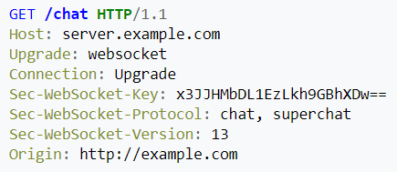
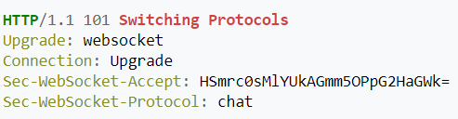
WebSocket (2)
WebSocket introduces a whole new way of two-way communication
Two-way communication (browser-server) is certainly a convenience
Before WebSocket, this was achieved in a rather non-standardized way
Using stopgap technologies such as Comet, for example
WebSocket communication is initiated trough a casual handshake
Client Request
Server Response

Slide 17
Remote Procedure Call (1)
Remote Procedure Call is an interprocess communication technique
A software causes a procedure execution in a different address space
Uses the Client-Server model
Used for point-to-point communication between apps
Sometimes called a function call / subroutine call
Remote Procedure Calls are naturally synchronous
The Sender (Client) must wait for the Executor (Server)’s result
There are some ways of achieving concurrency though

Slide 18
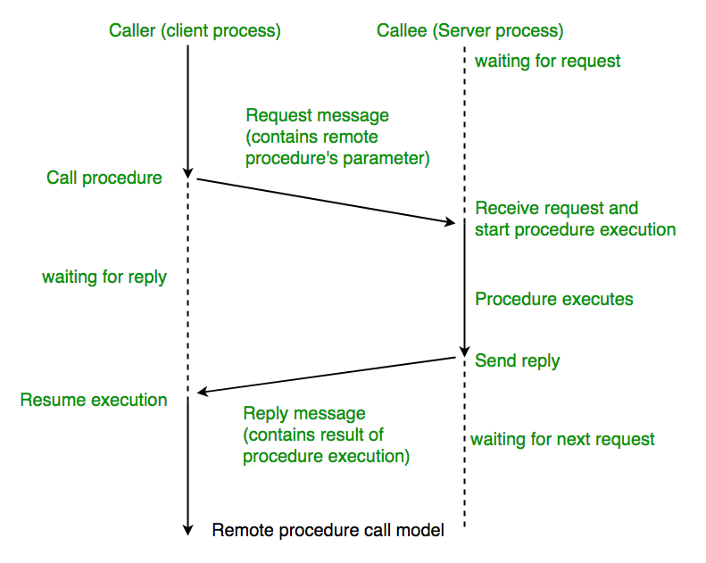
Remote Procedure Call (2)
When making a RPC
Procedure name and parameters are transferred over the network
Serialized
Procedure is executed and produces results
Results are transferred back
Serialized
Execution process resumes

Slide 19

Adding Real-Time Functionality to Your Apps
ASP.NET Core SignalR

Slide 20
ASP.NET Core SignalR (1)
ASP.NET Core SignalR is a library that simplifies adding RTC in web apps
RT functionality enables server content to be pushed to clients instantly
Good candidates for SignalR implementation include:
Apps that require high-frequency updates from the server
Gaming, Social Networks, Chat, Voting, Auction, Maps & GPS, etc.
Dashboards and monitoring apps – travel alerts, sales updates, etc.
Collaborative apps – Agile apps, Team Meeting apps, etc.
Apps that require notifications – Email, Chat, Social networks

Slide 21
ASP.NET Core SignalR (2)
SignalR provides API for creating server-to-client RPCs
The RPCs call JavaScript functions on clients and vice-versa
The RPCs are called from server-side .NET Code
Some of the core features of SignalR include:
Handling connection management automatically
Sending messages to all connected clients simultaneously (broadcast)
Sending messages to a specific client or group of clients
Scaling to handle increasing traffic (Azure SignalR Service)

Slide 22
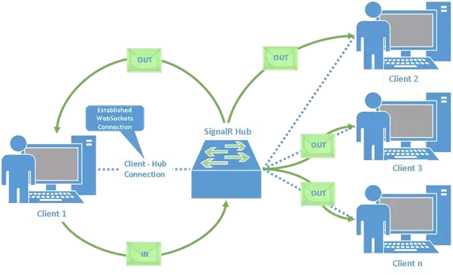

ASP.NET Core SignalR (3)
SignalR supports 3 techniques for handling RTC
WebSockets
Server-Sent Events
Long Polling
SingalR automatically chooses the best transport method
Chosen within the capabilities of the Server and Client

Slide 23


ASP.NET Core SignalR Hubs
SignalR uses hubs to establish communication client <–> server
A hub is high-level pipeline
Allows a Client and Server to call methods on each other
Hubs call client-side code by sending messages
These messages contain the method name and the parameters
Objects sent as method parameters are deserialized
The client tries to find a method, matching the given name
When the Client finds the method, it passes the parameters to it

Slide 24
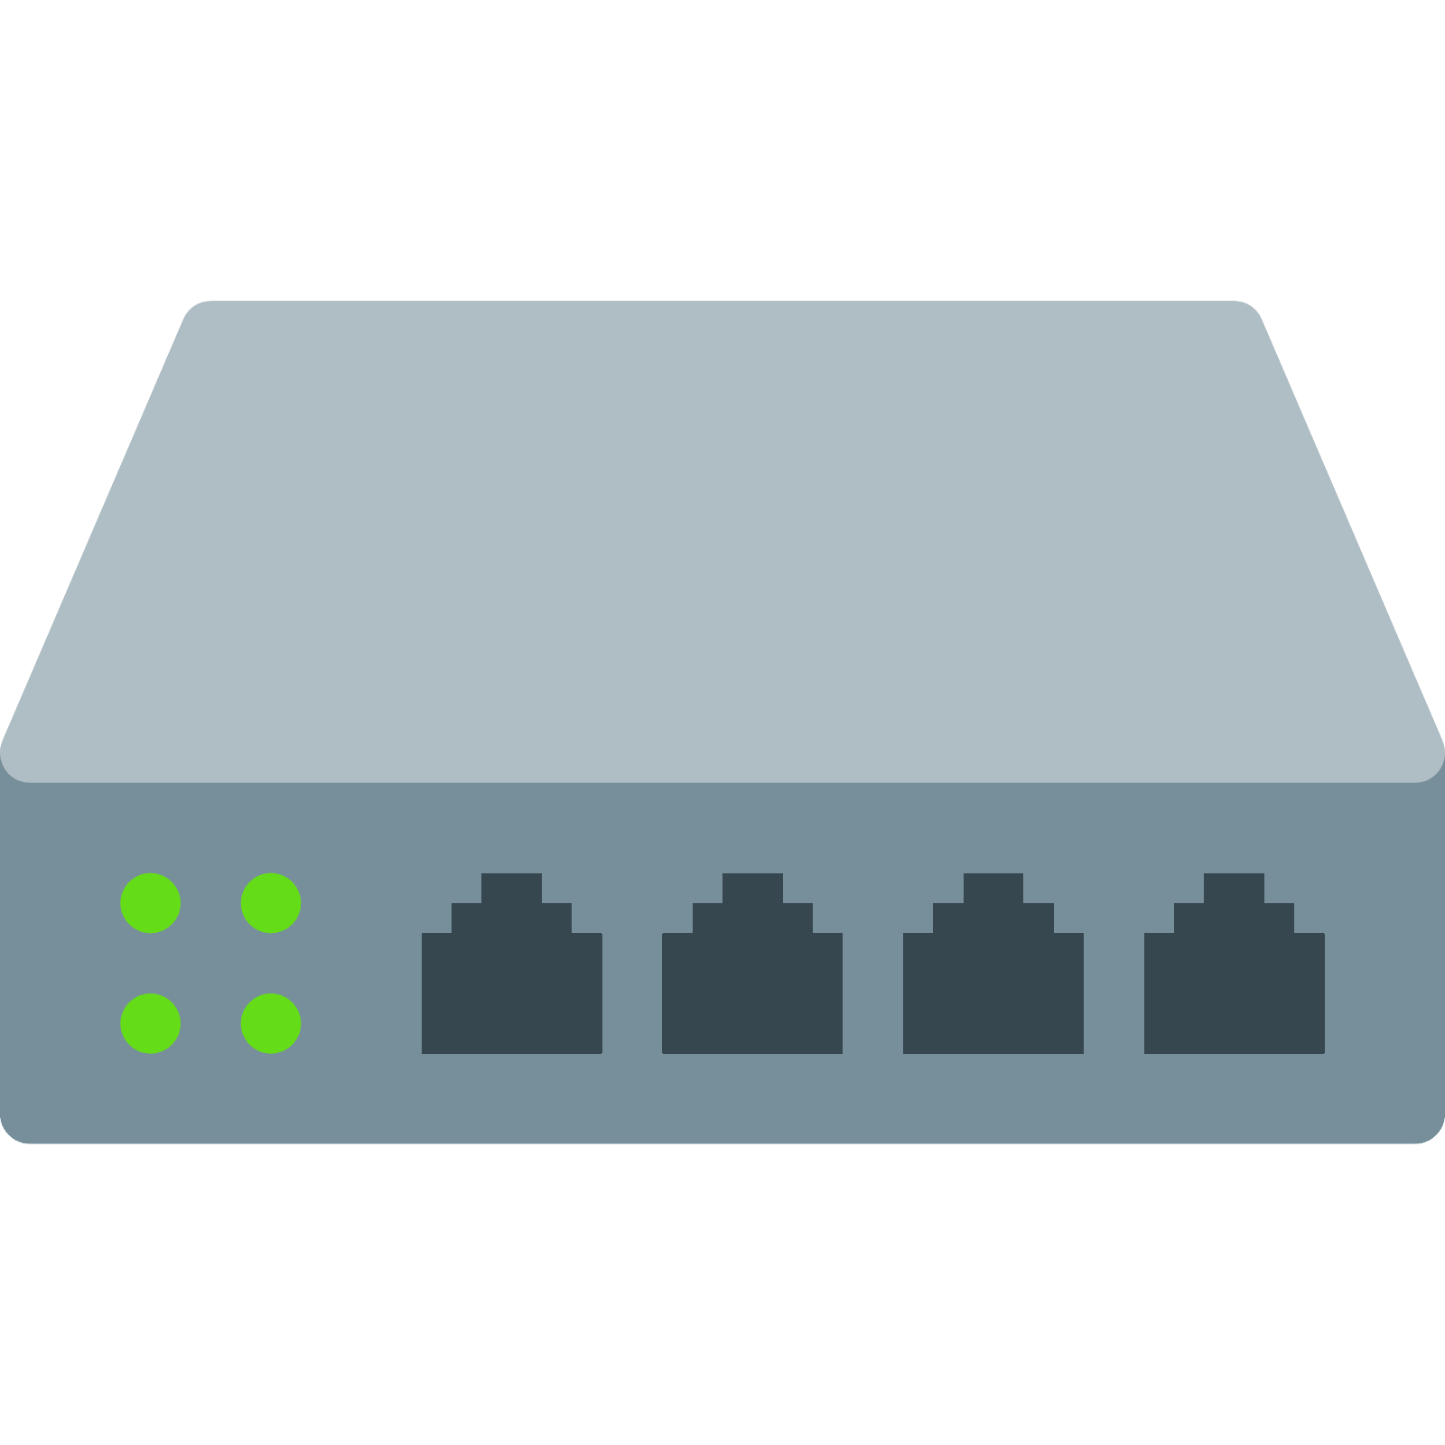
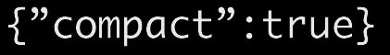
ASP.NET Core SignalR Hubs
You can pass Strongly-typed parameters to methods
This enables model binding on the server and vice-versa
These parameters are deserialized, using a configured protocol
SignalR provides 2 built-in hub protocols
A text protocol based on JSON
A binary protocol based on MessagePack
MessagePack generally creates smaller messages
Compared to the JSON format

Slide 25
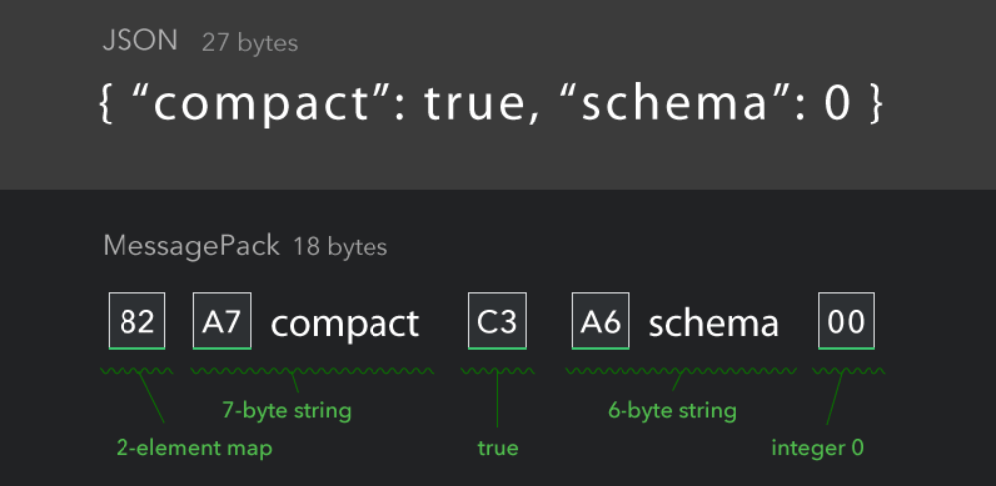
MessagePack
MessagePack is an efficient, binary serialization format
It's like JSON, but fast and small
MessagePack lets you exchange data among multiple languages
Small integers are encoded into a single byte
Typical short strings require only one extra byte
In addition to the strings themselves

Slide 26
ASP.NET Core SignalR Hubs
SignalR Hubs API provides a Hub class for applications to consume
The Hub class manages connections, groups, messaging
It also automatically manages the Identity system
This provides convenience and comfort when developing Hubs
The Hub class contains several helpful members
The Hub Context, The Hub Clients, The Group Manager
The Hub class contains methods for capturing Connection events
OnConnectedAsync() & OnDisconnectedAsync()

Slide 27
ASP.NET Core SignalR Hubs
The Hub Context is represented by the Context property
It contains properties with information about the connection
The most important properties provided by the Context are:
ConnectionId – Gets the unique Id for the connection
UserIdentifier – Gets the user identifier – ClaimTypes.NameIdentifier
User – Gets the ClaimsPrincipal associated with the current user
Items – Gets a key-value-pair collection, used for data sharing
The Context also holds the methods GetHttpContext and Abort

Slide 28
ASP.NET Core SignalR Hubs
The Hub Clients is represented by the Clients property
It contains properties for communication between server and client
The most important members provided by the Clients are:
All – Calls a method on all connected clients
Caller – Calls a method on the client that invoked the hub method
Others – Calls a method on all connected clients except the caller client
The Clients also holds many other methods for filtering clients
These methods helps specify particular clients

Slide 29

ASP.NET Core SignalR Hubs
The Group Manager is represented by the Groups property
It contains properties for managing client clustering
You can add Clients to a specific Group
Using AddToGroupAsync()
You can remove Clients from a specific Group
Using RemoveFromGroupAsync()
Grouping Clients helps you broadcast messages to specific auditories
In real-time apps, it is rarely needed to broadcast a message to all clients

Slide 30
SignalR Notes
SignalR code is asynchronous to ensure maximum scalability
Use await when calling async methods that depend on the Hub
Async methods can fail if the hub method completes first
Hub methods can return any type and receive any parameters
SignalR handles serialization and deserialization
Hubs are transient
Don't store state in a property on the hub class
Every hub method call is executed on a new hub instance

Slide 31
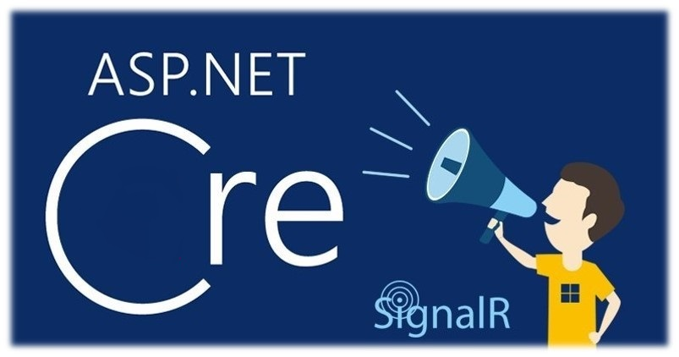
Creating a Very Simplistic Chat Application

Slide 32
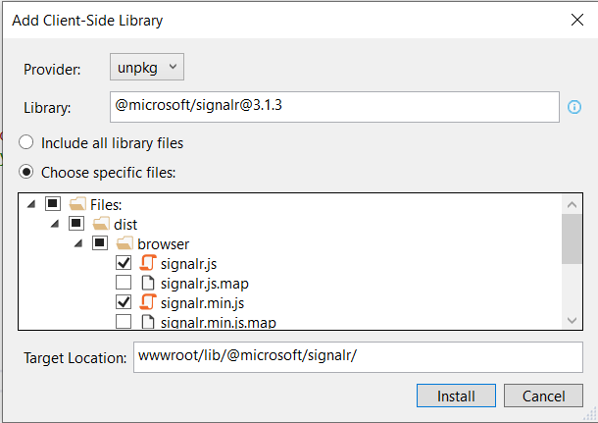
Including SignalR in ASP.NET Core
Simple Chat application in ASP.NET Core
Creating an empty project
In Solution Explorer, Right-click on the project, Add -> Client-Side Library

Slide 33
Including SignalR in ASP.NET Core
Simple Chat application in ASP.NET Core
ChatHub.cs class file
The ChatHub class inherits from the SignalR Hub class
The Hub class manages connections, groups and messaging
The SendMessage method can be called by any connected client
It sends the received message to all clients
public class ChatHub : Hub {
public async Task Send(string message) {
await this.Clients.All.SendAsync(
"NewMessage",
new Message { User = this.Context.User.Identity.Name, Text = message, });
}
}

Slide 34
Including SignalR in ASP.NET Core
Simple Chat application in ASP.NET Core
Configuring SignalR
public class Startup {
...
public void ConfigureServices(IServiceCollection services) {
services.AddSignalR();
}
public void Configure(IApplicationBuilder app, IHostingEnvironment env) {
app.UseEndpoints(endpoints =>
{
endpoints.MapControllerRoute(
name: "default",
pattern: "{controller=Home}/{action=Index}/{id?}");
endpoints.MapHub<ChatHub>("/chat"); //Configure ChatHub endpoint
}); ...
}
}

Slide 35
Including SignalR in ASP.NET Core
Simple Chat application in ASP.NET Core
JavaScript (Client) code - chat.js
var connection = new signalR.HubConnectionBuilder().withUrl("/chat").build();
// The Receive Message Client event. This will trigger, when the Back-End calls the ReceiveMessage method
connection.on("NewMessage", function (message) { ... });
//An error handler for connection errors
connection.start().catch(function (err) {
return console.error(err.toString());
});
// The Send Message DOM event. This will trigger the Back-End SendMessage method
document.getElementById("sendButton").addEventListener("click", function (event) { ... });

Slide 36
Including SignalR in ASP.NET Core
Simple Chat application in ASP.NET Core
connection.on("NewMessage", function (message) {
var msg = message.text.replace(/&/g, "&amp;").replace(/</g, "&lt;").replace(/>/g, "&gt;");
var encodedMsg = "[" + message.user + "]: " + msg;
var messageElement = document.createElement("h3");
messageElement.textContent = encodedMsg;
document.getElementById("messagesList")
.appendChild(messageElement);
});
document.getElementById("sendButton").addEventListener("click", function (event) {
var message = document.getElementById("messageInput").value;
connection.invoke("Send", message).catch(function (err) {
return console.error(err.toString());
});
event.preventDefault();
});

Slide 37

Summary
Real-Time Applications
Web Communication Fundamentals
Short Polling
Long Polling
Server-Sent Events
WebSockets
Remote Procedure Calls
ASP.NET Core SignalR
Real-time chat application with SignalR
…
…
…

Slide 38
Questions?
Notes:
38

Slide 39













SoftUni Diamond Partners

Slide 40


Educational Partners

Slide 41
Trainings @ Software University (SoftUni)
Software University – High-Quality Education, Profession and Job for Software Developers
softuni.bg, softuni.org
Software University Foundation
softuni.foundation
Software University @ Facebook
facebook.com/SoftwareUniversity
Software University Forums
forum.softuni.bg
Notes:
41

Slide 42

License
This course (slides, examples, demos, exercises, homework, documents, videos and other assets) is copyrighted content
Unauthorized copy, reproduction or use is illegal
© SoftUni – https://softuni.org
© Software University – https://softuni.bg
Notes:
42

